Slide 1
Sensor-independent illumination estimation for DNN models
Mahmoud Afifi¹ and Michael S. Brown^{1,2}
¹York University ²Samsung AI Center - Toronto

Slide 2
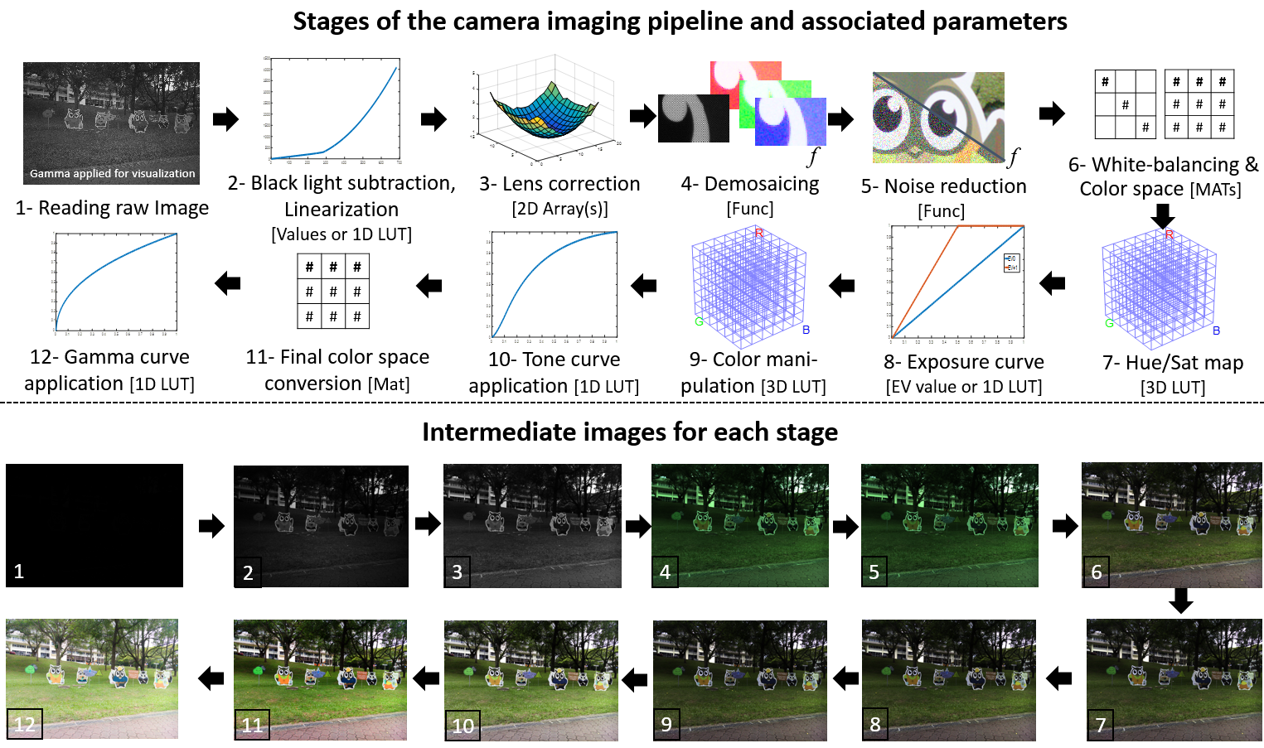
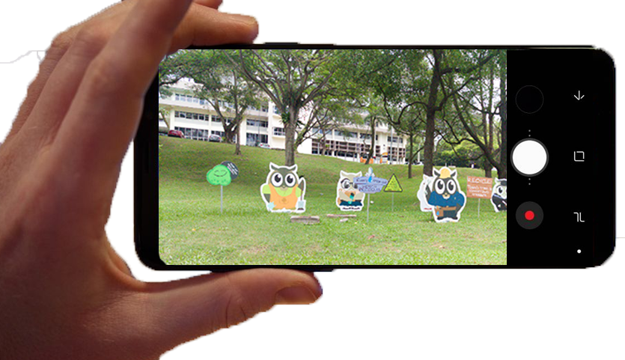
Onboard camera processing
When we capture a photograph,
a number of steps are applied onboard the camera to produce the final sRGB output image.
raw-RGB
sRGB
Figure from Karaimer and Brown [ECCV 2016]

Slide 3
A key routine in the pipeline is white balance
When we capture a photograph, a number of steps are applied onboard the camera to produce the final sRGB output image.
raw-RGB
sRGB

Slide 4
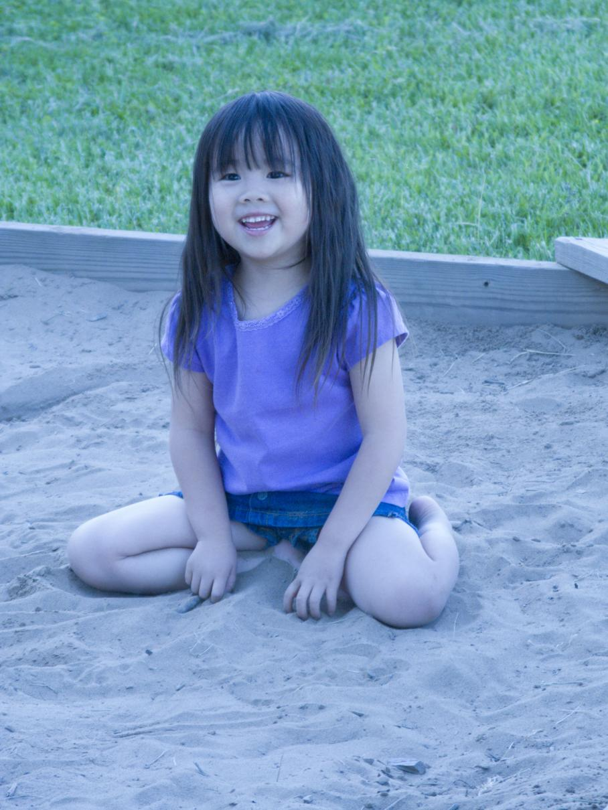
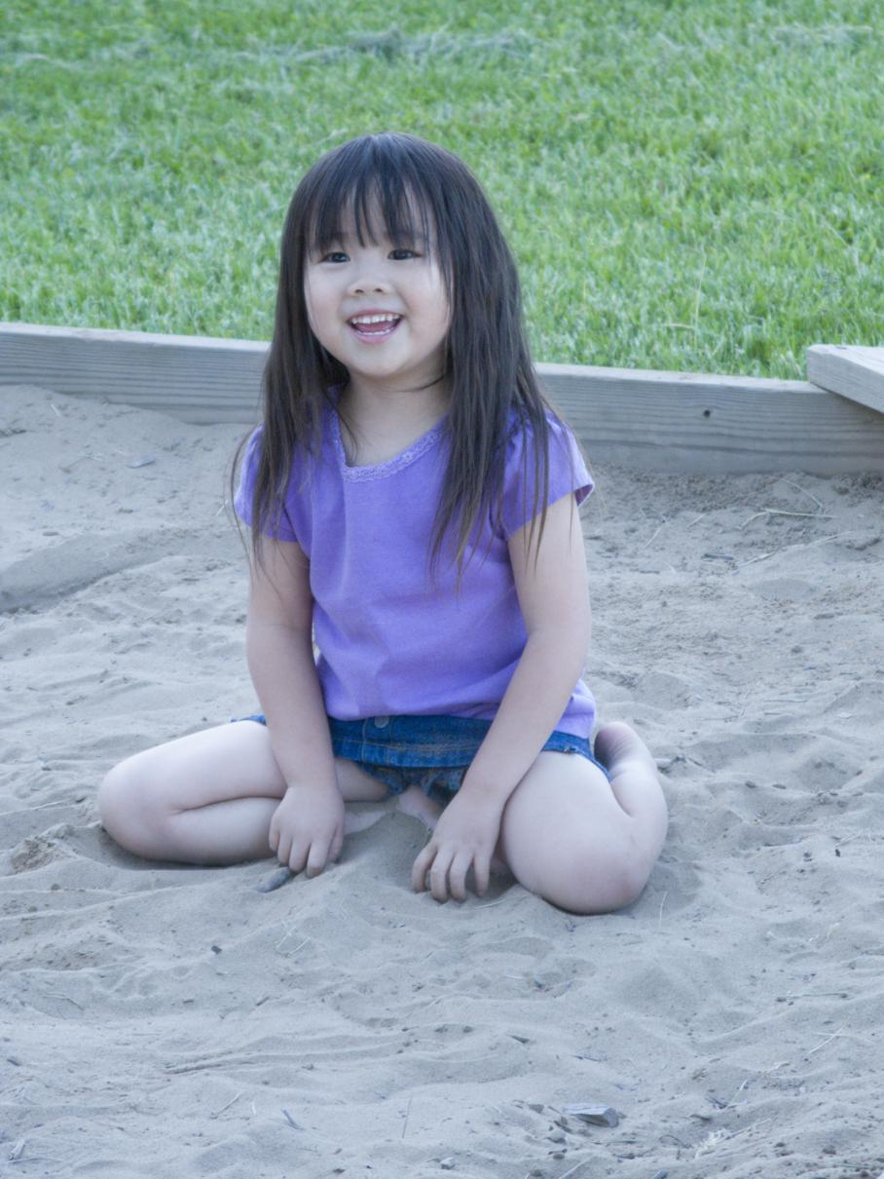
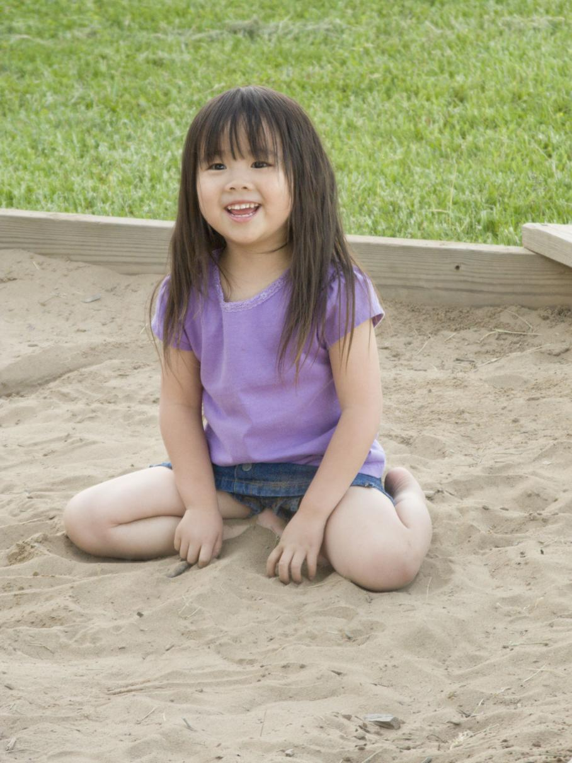
White balance is called computational colour constancy in computer vision
White balance is applied to remove the colour cast caused by the scene illumination.

Slide 5
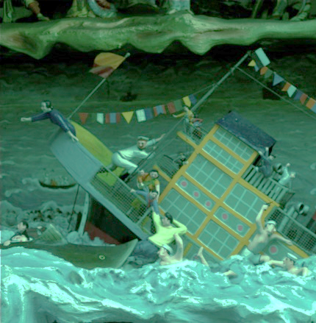
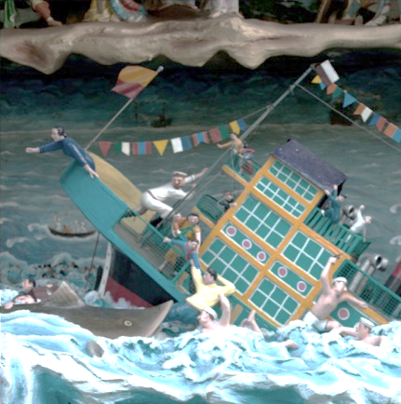
Illumination estimation
Sensor's response to illumination ($ℓ$)
$\left[\begin{matrix}ℓ_{r} \\ ℓ_{g} \\ ℓ_{b}\end{matrix}\right]$=
$$\left[\begin{matrix}0.2 \\ 0.8 \\ 0.8\end{matrix}\right]$$
raw-RGB image
“White-balanced”
raw-RGB image
$$\left[\begin{matrix}r_{wb} \\ g_{wb} \\ b_{wb}\end{matrix}\right]=\left[\begin{matrix}{1/ℓ}_{r} & & \\ & {1/ℓ}_{g} & \\ & & {1/ℓ}_{b}\end{matrix}\right]\left[\begin{matrix}r \\ g \\ b\end{matrix}\right]$$

Slide 6
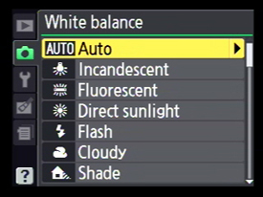
Illumination estimation
Illumination estimation algorithm
$$\left[\begin{matrix}ℓ_{r} \\ ℓ_{g} \\ ℓ_{b}\end{matrix}\right]$$
raw-RGB image
“White-balanced”
raw-RGB image
$$\left[\begin{matrix}r_{wb} \\ g_{wb} \\ b_{wb}\end{matrix}\right]=\left[\begin{matrix}{1/ℓ}_{r} & & \\ & {1/ℓ}_{g} & \\ & & {1/ℓ}_{b}\end{matrix}\right]\left[\begin{matrix}r \\ g \\ b\end{matrix}\right]$$

Slide 7
White balance is applied to raw-RGB
When we capture a photograph.
A number of steps are applied onboard the camera to produce the final sRGB output image.
raw-RGB
sRGB

Slide 8
Illumination estimation methods
Two main approaches to illumination estimation
Sensor-independent approaches
Rely on image colour statistics.
Grey-world [1980]
White-patch [1986]
Shades-of-grey [2004]
Grey-edge [2007]
PCA [2010]
…
Sensor-dependent approaches
Learning-based approaches via training data.
Gamut-based [1990]
Bayesian methods [2008]
Bias-correction [2013]
Decision-trees [2014]
…
DNNs
[2015 - foreseeable future]

Slide 9
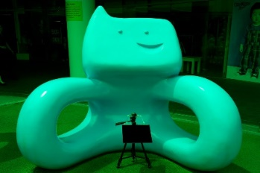
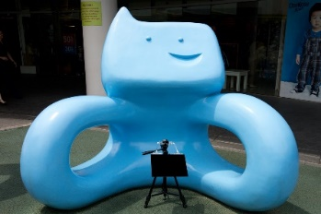
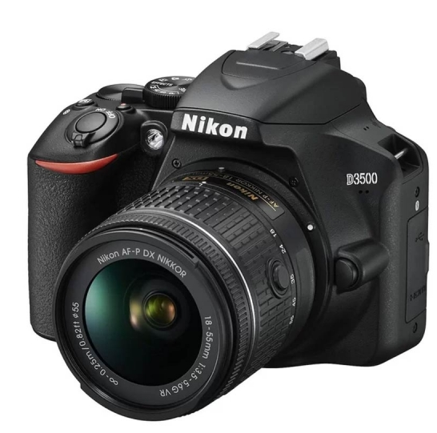
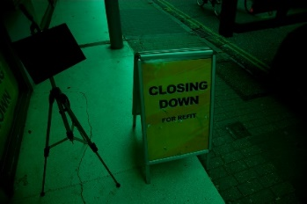
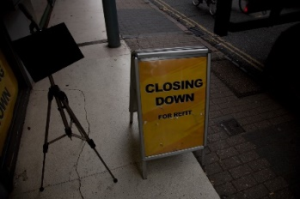
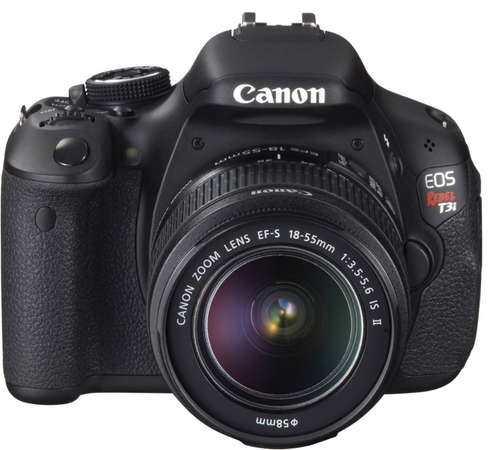
DNN-based approaches
Sensor X raw-RGB image
DNN model
for sensor X
White-balanced image
$$\left[\begin{matrix}ℓ_{r} \\ ℓ_{g} \\ ℓ_{b}\end{matrix}\right]$$
DNN model
for sensor Y
Sensor Y raw-RGB image
White-balanced image
$$\left[\begin{matrix}ℓ_{r} \\ ℓ_{g} \\ ℓ_{b}\end{matrix}\right]$$
DNN models are trained per sensor.

Slide 10
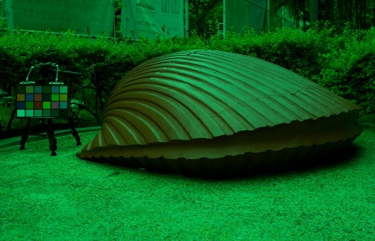
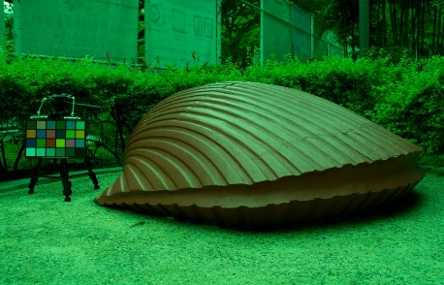
DNN-based approaches
Sensor
spectral sensitivity
Canon 600D raw-RGB image
R
G
$$GT=\left[\begin{matrix}0.082 \\ 0.419 \\ 0.219\end{matrix}\right]$$
B
Sensitivity
Wavelength
Sensor
spectral sensitivity
Nikon D5200 raw-RGB image
R
G
$$GT =\left[\begin{matrix}0.004 \\ 0.612 \\ 0.326\end{matrix}\right]$$
B
Sensitivity
Wavelength
Images from NUS-8 illumination estimation dataset

Slide 11
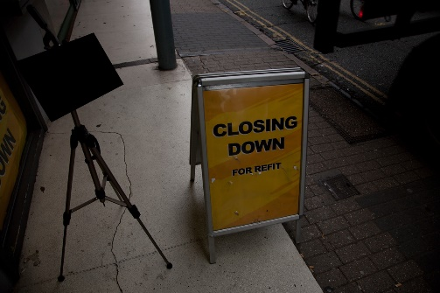
Our proposed method
Sensor-independent framework
Sensor X raw-RGB image
White-balanced image
(1) Sensor-mapping network
(2) Illumination estimation
network
Sensor Y raw-RGB image
White-balanced image

Slide 12
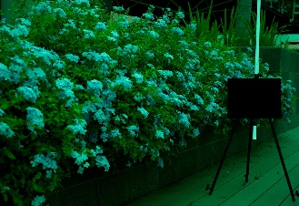
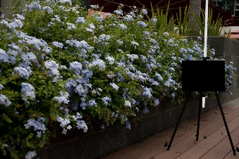
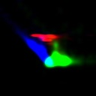
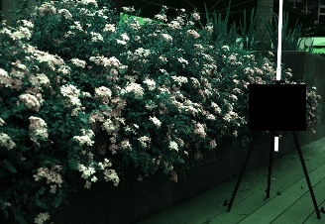
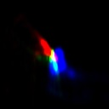
Overall framework and network architecture
Image mapping matrix
M
RGB-uv histogram for sensor mapping
Sensor mapping network
conv/ReLU
128 5x5 with
stride = 2
conv/ReLU
256 3x3 with
stride = 2
RGB-uv histogram block
conv/ReLU
512 2x2 with
stride = 1
fc
9
$$\left[\begin{matrix}\# & \# & \# \\ \# & \# & \# \\ \# & \# & \#\end{matrix}\right]$$
raw-RGB image $I$
White-balanced image
Input raw-RGB image $I$
Mapping input image from original raw
space to the learned working space
Final
estimated
illuminant
$$^$$
$$×$$
$$ℓ$$
RGB-uv histogram for illuminant estimation
Mapped
Illuminant $ℓ$_{m}
M⁻¹
$$^$$
Illuminant estimation network
$$^$$
$ℓ$_{m}
$${\left[\begin{matrix}\# & \# & \# \\ \# & \# & \# \\ \# & \# & \#\end{matrix}\right]}^{−1}$$
$$\left[\begin{matrix}\# \\ \# \\ \#\end{matrix}\right]$$
RGB-uv histogram block
conv/ReLU
128 5x5 with
stride = 2
conv/ReLU
256 3x3 with
stride = 2
$$\left[\begin{matrix}\# \\ \# \\ \#\end{matrix}\right]$$
$$×$$
conv/ReLU
512 2x2 with
stride = 1
fc
3
Mapped image
$I_{m}=$M$I$
Mapping to original
raw space

Slide 13
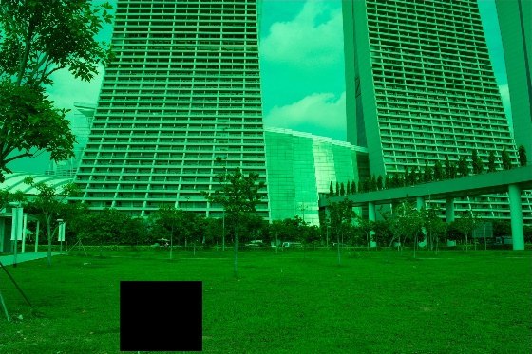
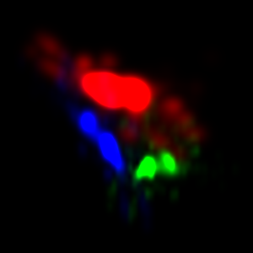
Starting point: RGB–uv histogram block
We build on the RGB-uv histogram feature from [1,2] by adding two learnable parameters to control the contribution of each color channel in the generated histogram and the smoothness of histogram bins.
Input raw-RGB image
Generated RGB-uv
histogram
[1] J. Barron, Convolutional Color Constancy, ICCV, 2015.
[2] M. Afifi et al., When Color Constancy Goes Wrong, CVPR, 2019.

Slide 14
Sensor space mapping network
Input image histogram
conv/ReLU
128 5x5 with
stride = 2
conv/ReLU
256 3x3 with
stride = 2
conv/ReLU
512 2x2 with
stride = 1
fc
9
$$V ∈ℝ^{9}$$
$$\left[\begin{matrix}\# & \# & \# \\ \# & \# & \# \\ \# & \# & \#\end{matrix}\right]$$
$$\text{M}$$
$\text{We} \text{add} \text{small} ε \text{to} \text{each} \text{parameter} \text{in} \text{M} \text{to} \text{ensure} \text{it} \text{is} \text{invertible}$.

Slide 15
Illumination estimation network
Mapped image histogram
conv/ReLU
128 5x5 with
stride = 2
conv/ReLU
256 3x3 with
stride = 2
conv/ReLU
512 2x2 with
stride = 1
fc
3
$$^$$
$ℓ$_{m}
$$∈ℝ^{3}$$
Mapped image
$I_{m}=$M$I$
Mapped raw-RGB image

Slide 16
Training and loss function
The two networks are jointly trained in an end-to-end manner.
Error is the angular error loss $L$, given by:
$$L\left({\hat{ℓ}}_{m},\text{M}\right)=\cos^{−1}\left(\frac{ℓ_{GT}⋅\left({\text{M}}^{−1}{\hat{ℓ}}_{m}\right)}{\left\|ℓ_{GT}\right\|\left\|{\text{M}}^{−1}{\hat{ℓ}}_{m}\right\|}\right)$$
Estimated
R
GT
B
G

Slide 17
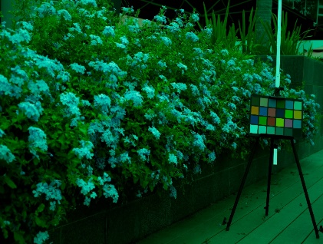
Training and loss function
Image mapping matrix
$$\text{M}$$
Ground Truth
RGB-uv histogram for sensor mapping
Sensor mapping network
conv/ReLU
128 5x5 with
stride = 2
conv/ReLU
256 3x3 with
stride = 2
RGB-uv histogram block
conv/ReLU
512 2x2 with
stride = 1
fc
9
$$\left[\begin{matrix}\# & \# & \# \\ \# & \# & \# \\ \# & \# & \#\end{matrix}\right]$$
Input raw-RGB image $I$
Mapping input image from original raw
space to the learned working space
$$×$$
$$ℓ_{GT}$$
Angular Error Loss
RGB-uv histogram for illuminant estimation
Illuminant estimation network
Mapped
Illuminant $ℓ$_{m}
$$^$$
$${\text{M}}^{−1}ℓ_{m}$$
RGB-uv histogram block
conv/ReLU
128 5x5 with
stride = 2
conv/ReLU
256 3x3 with
stride = 2
$$\left[\begin{matrix}\# \\ \# \\ \#\end{matrix}\right]$$
conv/ReLU
512 2x2 with
stride = 1
fc
3
$$^$$
Mapped image
$I_{m}=$M$I$
M⁻¹
$ℓ$_{m}
$${\left[\begin{matrix}\# & \# & \# \\ \# & \# & \# \\ \# & \# & \#\end{matrix}\right]}^{−1}$$
$$\left[\begin{matrix}\# \\ \# \\ \#\end{matrix}\right]$$
$$×$$
Mapping to original
raw space
$$\cos^{−1}\left(\frac{ℓ_{GT}.\left({\text{M}}^{−1}ℓ_{m}\right)}{\left\|ℓ_{GT}\right\|\left\|{\text{M}}^{−1}ℓ_{m}\right\|}\right)$$
Angular error Loss =

Slide 18
Training and loss function
Image mapping matrix
$$\text{M}$$
Ground Truth
RGB-uv histogram for sensor mapping
Sensor mapping network
conv/ReLU
128 5x5 with
stride = 2
conv/ReLU
256 3x3 with
stride = 2
RGB-uv histogram block
conv/ReLU
512 2x2 with
stride = 1
fc
9
$$\left[\begin{matrix}\# & \# & \# \\ \# & \# & \# \\ \# & \# & \#\end{matrix}\right]$$
Input raw-RGB image $I$
Mapping input image from original raw
space to the learned working space
$$×$$
$$ℓ_{GT}$$
Angular Error Loss
RGB-uv histogram for illuminant estimation
Illuminant estimation network
Mapped
Illuminant $ℓ$_{m}
$$^$$
$${\text{M}}^{−1}ℓ_{m}$$
RGB-uv histogram block
conv/ReLU
128 5x5 with
stride = 2
conv/ReLU
256 3x3 with
stride = 2
$$\left[\begin{matrix}\# \\ \# \\ \#\end{matrix}\right]$$
conv/ReLU
512 2x2 with
stride = 1
fc
3
$$^$$
Mapped image
$I_{m}=$M$I$
M⁻¹
$ℓ$_{m}
$${\left[\begin{matrix}\# & \# & \# \\ \# & \# & \# \\ \# & \# & \#\end{matrix}\right]}^{−1}$$
$$\left[\begin{matrix}\# \\ \# \\ \#\end{matrix}\right]$$
$$×$$
Mapping to original
raw space
$$\cos^{−1}\left(\frac{ℓ_{GT}.\left({\text{M}}^{−1}ℓ_{m}\right)}{\left\|ℓ_{GT}\right\|\left\|{\text{M}}^{−1}ℓ_{m}\right\|}\right)$$
Angular error Loss =

Slide 19
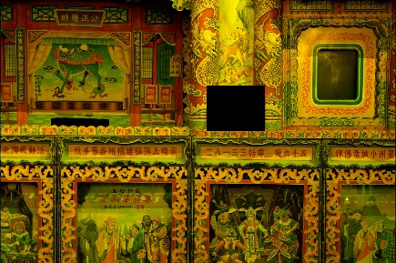
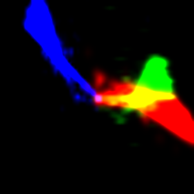
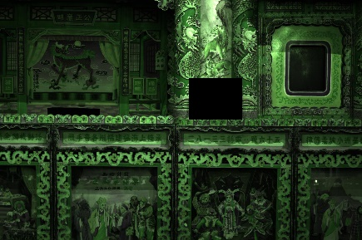
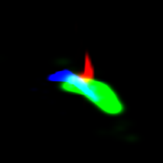
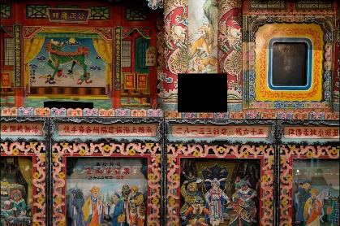
Test time example #1
Testing raw-RGB image
(Fujifilm XM1)
Sensor mapping
net
Mapping matrix
RGB-uv histogram block
$$\left[\begin{matrix}0.34 & 0.32 & 0.00 \\ 0.06 & 0.17 & 0.49 \\ 0.04 & 0.93 & 0.031\end{matrix}\right]$$
$$×$$
Illuminant estimation net
Estimated illuminant in the working space
RGB-uv histogram block
$$\left[\begin{matrix}0.46 \\ 0.24 \\ 0.64\end{matrix}\right]$$
"working space"
Project back to the original raw-RGB space
$${\left[\begin{matrix}0.34 & 0.32 & 0.00 \\ 0.06 & 0.17 & 0.49 \\ 0.04 & 0.93 & 0.031\end{matrix}\right]}^{−1}×\left[\begin{matrix}0.46 \\ 0.24 \\ 0.64\end{matrix}\right]=\left[\begin{matrix}0.74 \\ 0.65 \\ 0.17\end{matrix}\right]$$
White-balanced raw-RGB

Slide 20
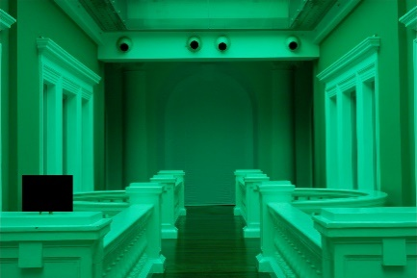
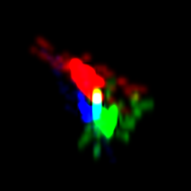
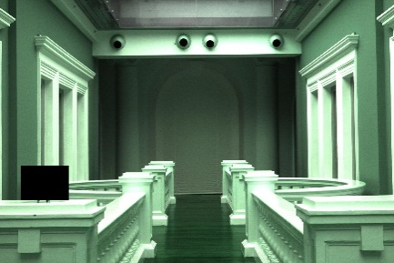
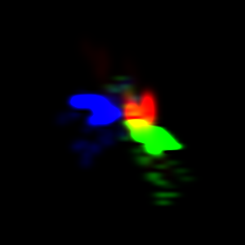
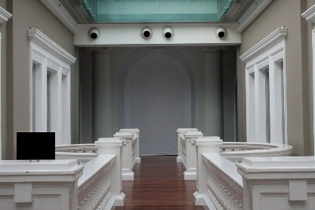
Test time example #2
Testing raw-RGB image
(Canon 1Ds Mk III)
Sensor mapping
network
Mapping matrix
RGB-uv histogram block
$$\left[\begin{matrix}0.91 & 0.05 & 0.04 \\ 0.03 & 0.02 & 0.53 \\ 0.0 & 0.98 & 0.01\end{matrix}\right]$$
$$×$$
Illuminant estimation net
Estimated illuminant in the working space
RGB-uv histogram block
$$\left[\begin{matrix}0.38 \\ 0.29 \\ 0.77\end{matrix}\right]$$
"working space"
Project back to the original raw-RGB space
$${\left[\begin{matrix}0.91 & 0.05 & 0.04 \\ 0.03 & 0.02 & 0.53 \\ −0.0 & 0.98 & 0.01\end{matrix}\right]}^{−1}×\left[\begin{matrix}0.38 \\ 0.29 \\ 0.77\end{matrix}\right]=\left[\begin{matrix}0.36 \\ 0.78 \\ 0.51\end{matrix}\right]$$
White-balanced raw-RGB

Slide 21
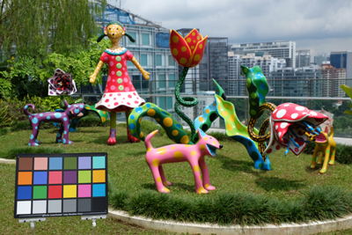
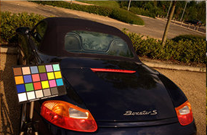
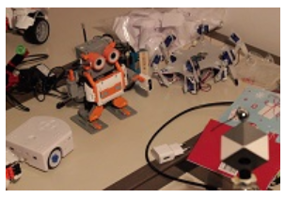
Experimental results
All camera models in:
NUS 8-Camera dataset (8 camera models)
Gehler-Shi dataset (2 camera models)
Cube/Cube+ dataset (1 camera model)
NUS-8 dataset
Gehler-Shi dataset
Cube/Cube+ datasets

Slide 22
Results
Angular errors
Methods | NUS 8-Camera |  |  |  | Gehler-Shi
 | Mean | Median | Best 25% | Worst 25% | Mean | Median | Best 25% | Worst 25%
Avg. sensor-independent methods | 4.26 | 3.25 | 0.99 | 9.43 | 5.10 | 4.03 | 1.91 | 10.77
Avg. sensor-dependent methods | 2.40 | 1.64 | 0.50 | 5.75 | 2.62 | 1.75 | 0.50 | 5.95
Ours | 2.05 | 1.50 | 0.52 | 4.48 | 2.77 | 1.93 | 0.55 | 6.53
Sensor-independent methods
- J. Van De Weijer, et al., Edge-based color constancy, TIP, 2007
- S. Bianco and C. Cusano, Quasi-unsupervised color constancy, In CVPR’19
- Y. Qian, et al., On finding gray pixels, In CVPR’19
Sensor-dependent methods
- W. Shi, et al., Deep specialized network for illuminant estimation, In ECCV’16
- . J. T. Barron and Y.-T. Tsai, Fast Fourier color constancy,
In CVPR’17
- Y. Hu, et al., FC4: Fully convolutional color constancy with confidence-weighted pooling, In CVPR’17

Slide 23
Results
Angular errors
Methods | Cube |  |  |  | Cube+
 | Mean | Median | Best 25% | Worst 25% | Mean | Median | Best 25% | Worst 25%
Avg. sensor-independent methods | 3.57 | 2.47 | 0.64 | 8.30 | 4.98 | 3.32 | 0.82 | 11.77
Avg. sensor-dependent methods | 1.54 | 0.92 | 0.26 | 3.85 | 2.04 | 1.02 | 0.25 | 5.58
Ours | 1.98 | 1.36 | 0.40 | 4.64 | 2.14 | 1.44 | 0.44 | 5.06
Sensor-independent methods
- J. Van De Weijer, et al., Edge-based color constancy, TIP, 2007
- S. Bianco and C. Cusano, Quasi-unsupervised color constancy, In CVPR’19
- Y. Qian, et al., On finding gray pixels, In CVPR’19
Sensor-dependent methods
- W. Shi, et al., Deep specialized network for illuminant estimation, In ECCV’16
- . J. T. Barron and Y.-T. Tsai, Fast Fourier color constancy,
In CVPR’17
- Y. Hu, et al., FC4: Fully convolutional color constancy with confidence-weighted pooling, In CVPR’17

Slide 24
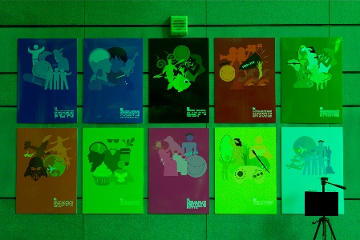
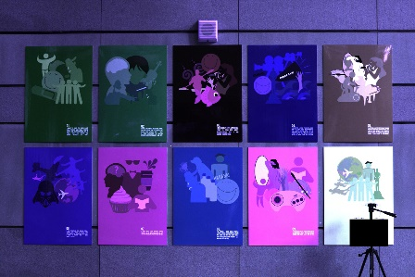
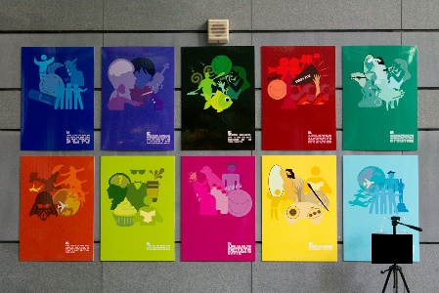
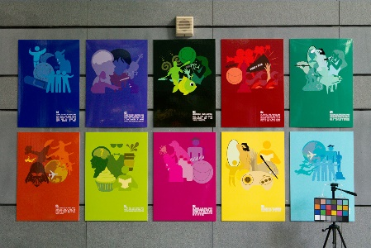
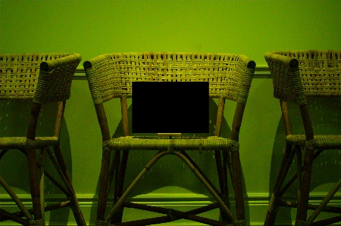
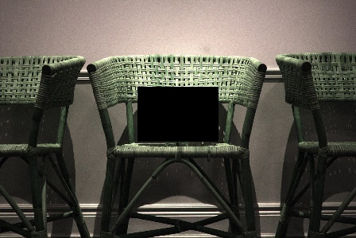
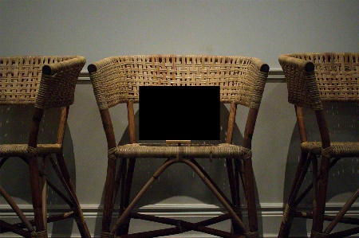
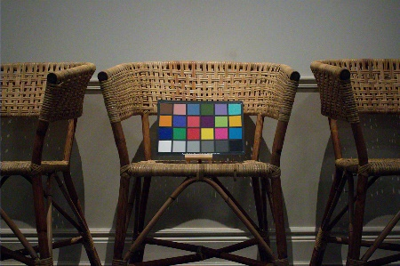
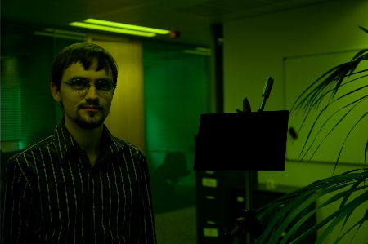
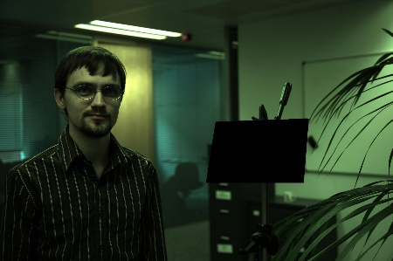
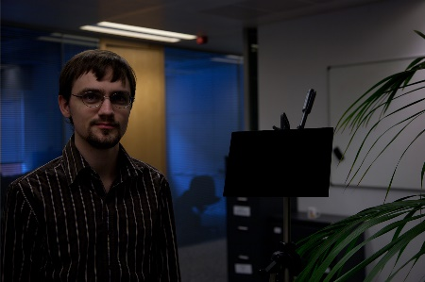
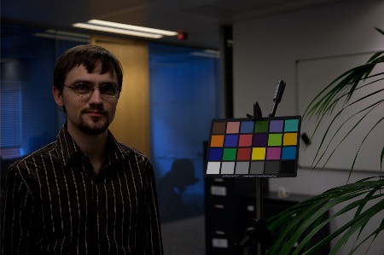
Results
Samsung NX
Angular error = 0.98°
Canon 600D
Angular error = 0.43°
Canon 5D
Angular error = 1.29°
Input raw-RGB images
Mapped images
Corrected images
Ground truth
Images from NUS 8-Cameras and Gehler-Shi datasets

Slide 25
Summary
Presented a deep learning framework for sensor-independent illumination estimation
Our method learns an image-specific mapping to transform different camera raw-RGB images into a canonical "working space"
Our framework is on par with sensor-dependent DNNs, but requires only a single DNN.

Slide 26
Thank you
Questions?
Image mapping matrix
M
RGB-uv histogram for sensor mapping
Sensor mapping network
conv/ReLU
128 5x5 with
stride = 2
conv/ReLU
256 3x3 with
stride = 2
RGB-uv histogram block
conv/ReLU
512 2x2 with
stride = 1
fc
9
$$\left[\begin{matrix}\# & \# & \# \\ \# & \# & \# \\ \# & \# & \#\end{matrix}\right]$$
White-balanced image
Input raw-RGB image $I$
Mapping input image from original raw
space to the learned working space
Final
estimated
illuminant
$$^$$
$$×$$
$$ℓ$$
RGB-uv histogram for illuminant estimation
Mapped
Illuminant $ℓ$_{m}
M⁻¹
$$^$$
Illuminant estimation network
$$^$$
$ℓ$_{m}
$${\left[\begin{matrix}\# & \# & \# \\ \# & \# & \# \\ \# & \# & \#\end{matrix}\right]}^{−1}$$
$$\left[\begin{matrix}\# \\ \# \\ \#\end{matrix}\right]$$
RGB-uv histogram block
conv/ReLU
128 5x5 with
stride = 2
conv/ReLU
256 3x3 with
stride = 2
$$\left[\begin{matrix}\# \\ \# \\ \#\end{matrix}\right]$$
$$×$$
conv/ReLU
512 2x2 with
stride = 1
fc
3
Mapped image
$I_{m}=$M$I$
Mapping to original
raw space

